Slide 1
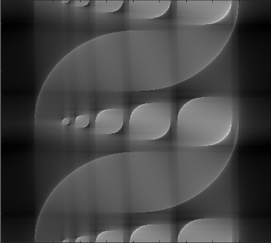
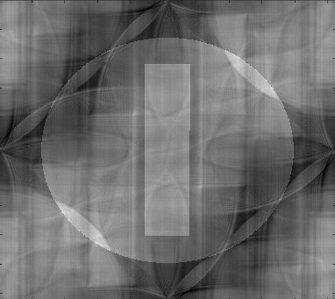
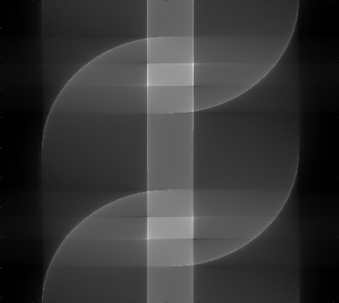
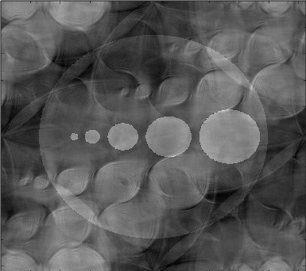
Virtual MRI Scanner
12.03.24
By: Raphael Tinoco, David Palacios, Nam Phung, Kevin Macedo
Fundamentals of Medical Imaging

Slide 2
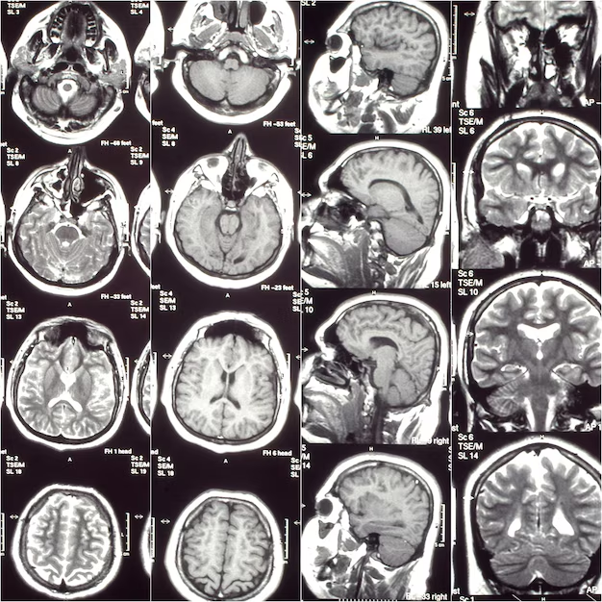
Simulating a Virtual Scan
Process
Virtual MRI Scanner
Begin with a target image
Data collection occurs in the K-space
Choice of acquisition trajectory (Cartesian or Radial)
Scanning of k-space
Image reconstruction
Comparison of image post reconstruction

Slide 3

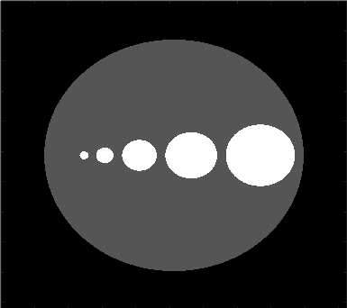
Target Images
Process
Virtual MRI Scanner
Phantom One
Phantom Two
Two Phantoms generated with MATLAB’s phantom() function
Not yet ready to be scanned

Slide 4
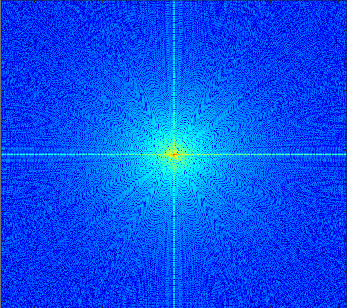
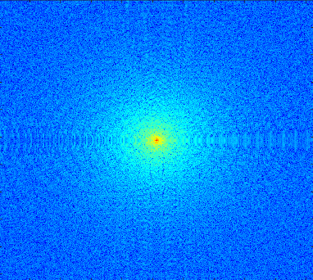
Transforming to K-space
Process
Virtual MRI Scanner
Phantom One
Phantom Two
MATLAB’s fft() and ifft() functions
Ready to be scanned via chosen acquisition trajectory

Slide 5
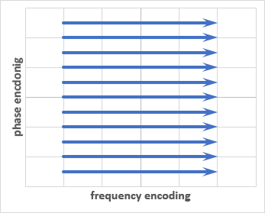
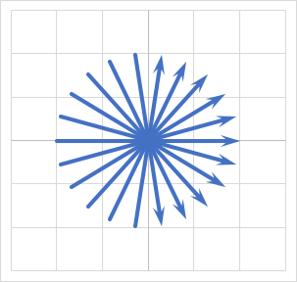
Acquisition Parameters
Process
Virtual MRI Scanner
Cartesian
Radial
Cartesian
Line Density
Point Density
Matrix Width
Swap Horizontal / Vertical Lines
Radial
Radial Density
Point Density
Images from: http://xrayphysics.com/traject.html

Slide 6
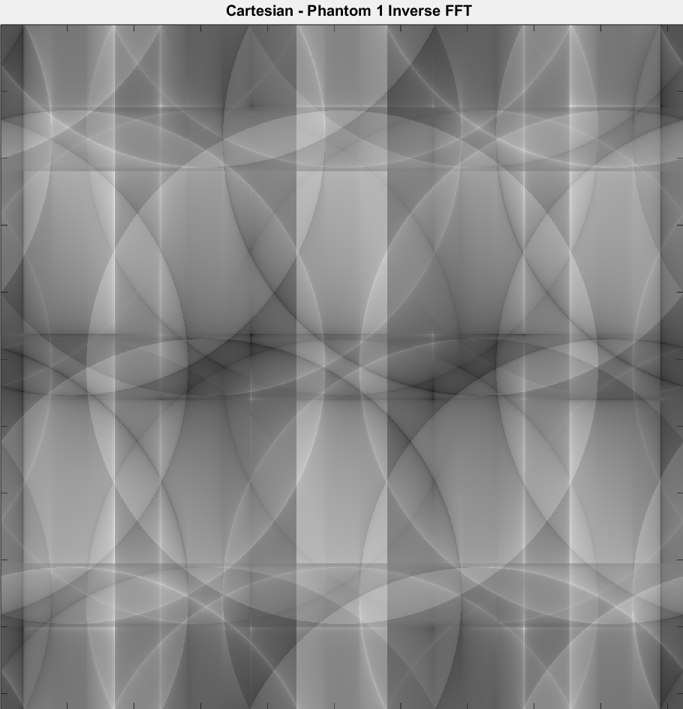
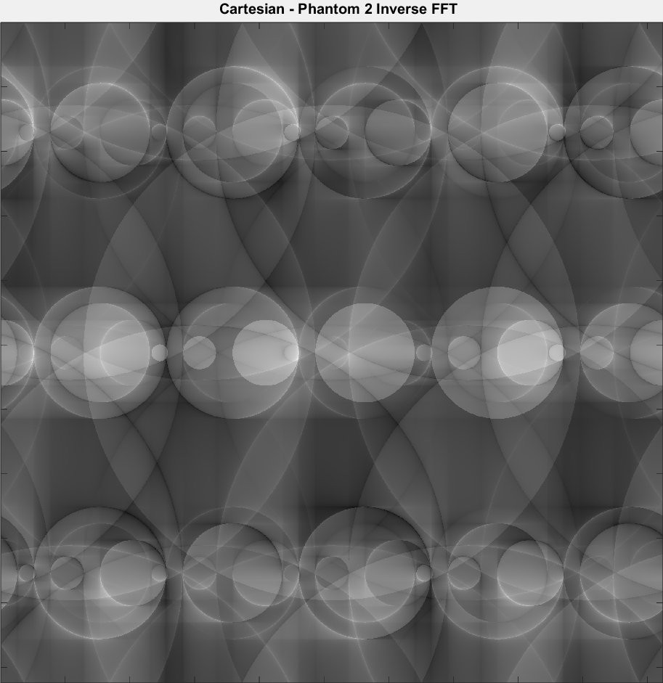
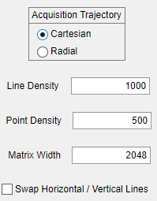
Cartesian Acquisition Trajectory
Process
Virtual MRI Scanner

Slide 7
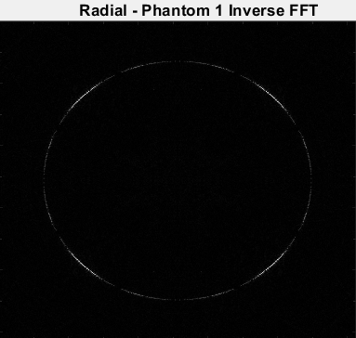
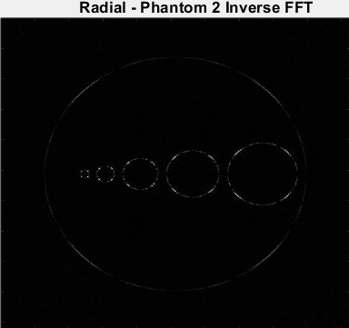
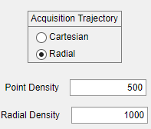
Radial Acquisition Trajectory
Process
Virtual MRI Scanner

Slide 8
Image Comparisons (Cartesian)
Process
Virtual MRI Scanner
Outer circular structure visible in both outputs
Can see inner regions in outputs as well, though duplication occurs

Slide 9
Image Comparisons (Radial)
Process
Virtual MRI Scanner
Degradation of quality for both phantoms
Closer appearance in phantom 2
Oversampling occurs in the center
Center of k-space holding much of the original image contrast
Resulting image therefore has better contrast

Slide 10
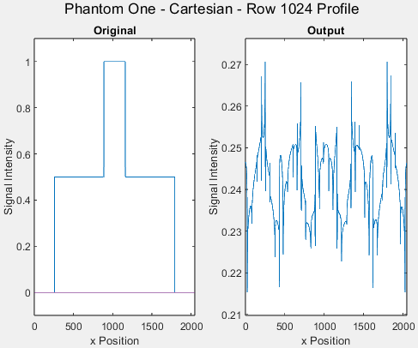
Image Profiles (Cartesian)
Process
Virtual MRI Scanner
Horizontal direction at mid row
Notice rise as x approaches the middle column in the original
Output profile more sporadic due to “duplication”

Slide 11
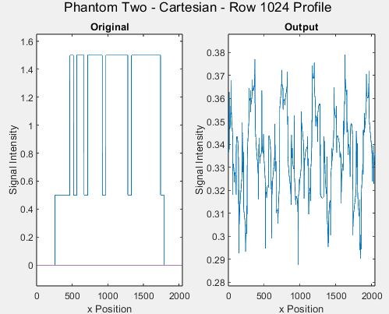
Image Profiles (Cartesian)
Process
Virtual MRI Scanner
Horizontal direction at mid row
Rise of SI occurs for each inner circle column in original
As an inner circle is of bigger size, more positions show high SI values (thicker lines in the profile)
Same idea for output

Slide 12
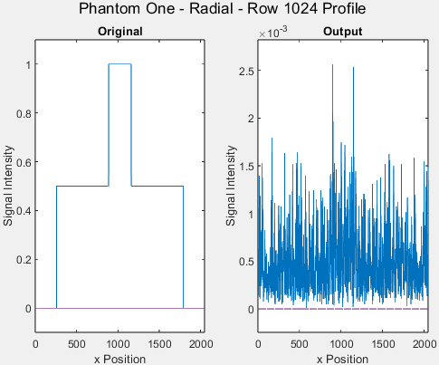
Image Profiles (Radial)
Process
Virtual MRI Scanner
Horizontal direction at mid row
Output profile more sporadic due to noise scattered throughout
Lack of center region in output

Slide 13

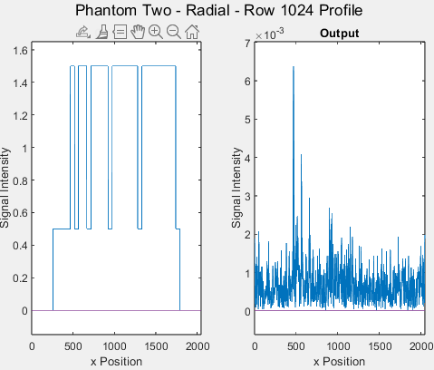
Image Profiles
Process
Virtual MRI Scanner
Horizontal direction at mid row
Sporadic output due to noise
Brightest region of the output seemingly on its left half

Slide 14
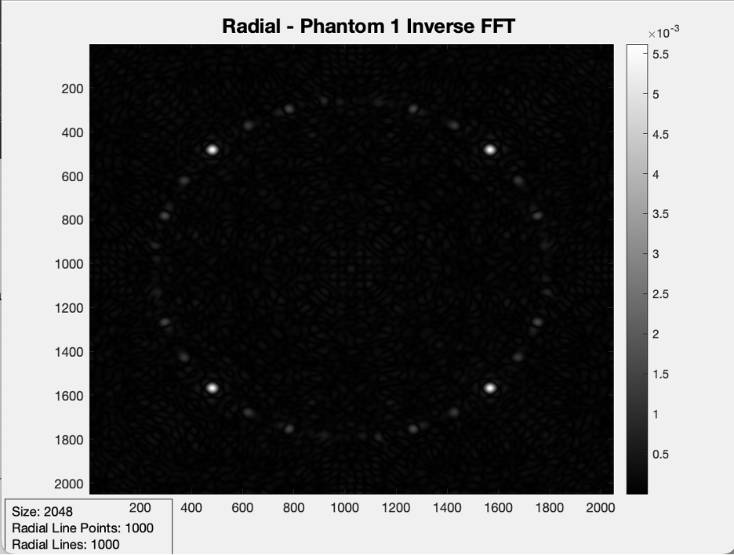
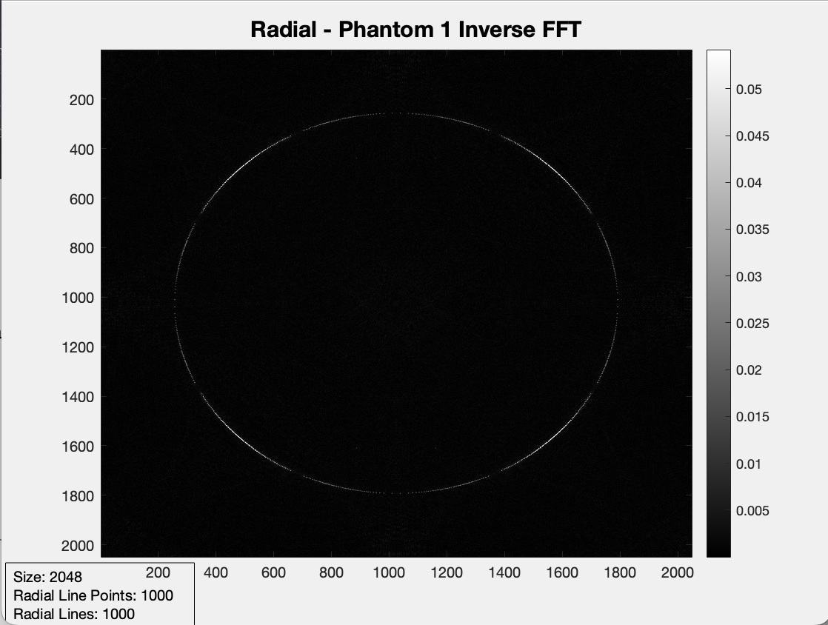

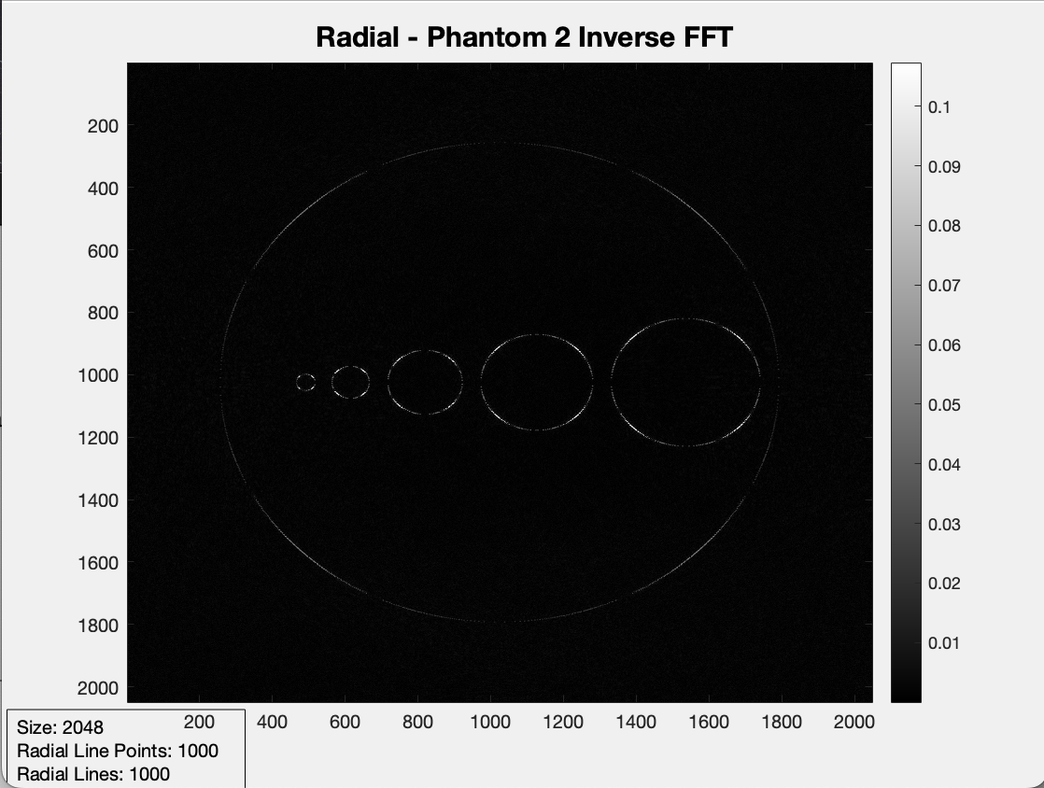
Image Comparisons (Radial: Acquisition Time)
Process
Virtual MRI Scanner
Acquisition Time: 0.1
Acquisition Time: 0.9
Acquisition Time Value can be any value between 0 and 1
Visual Clarity for the phantom when increasing the Acquisition Time value

Slide 15
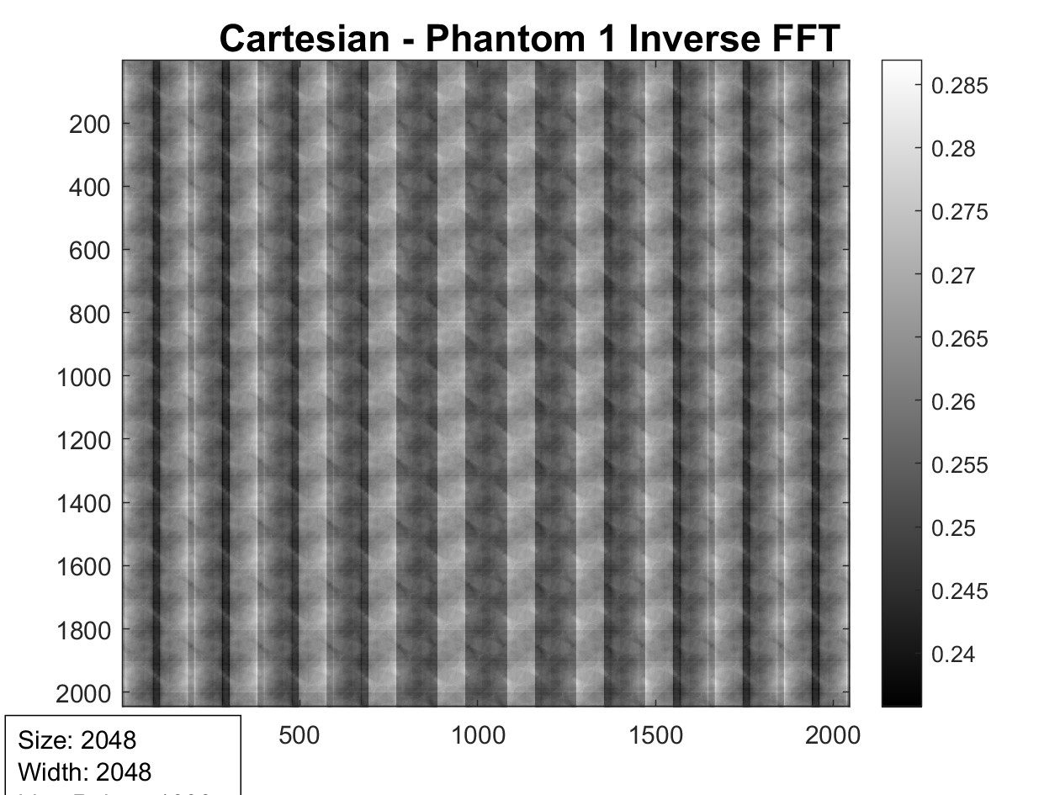
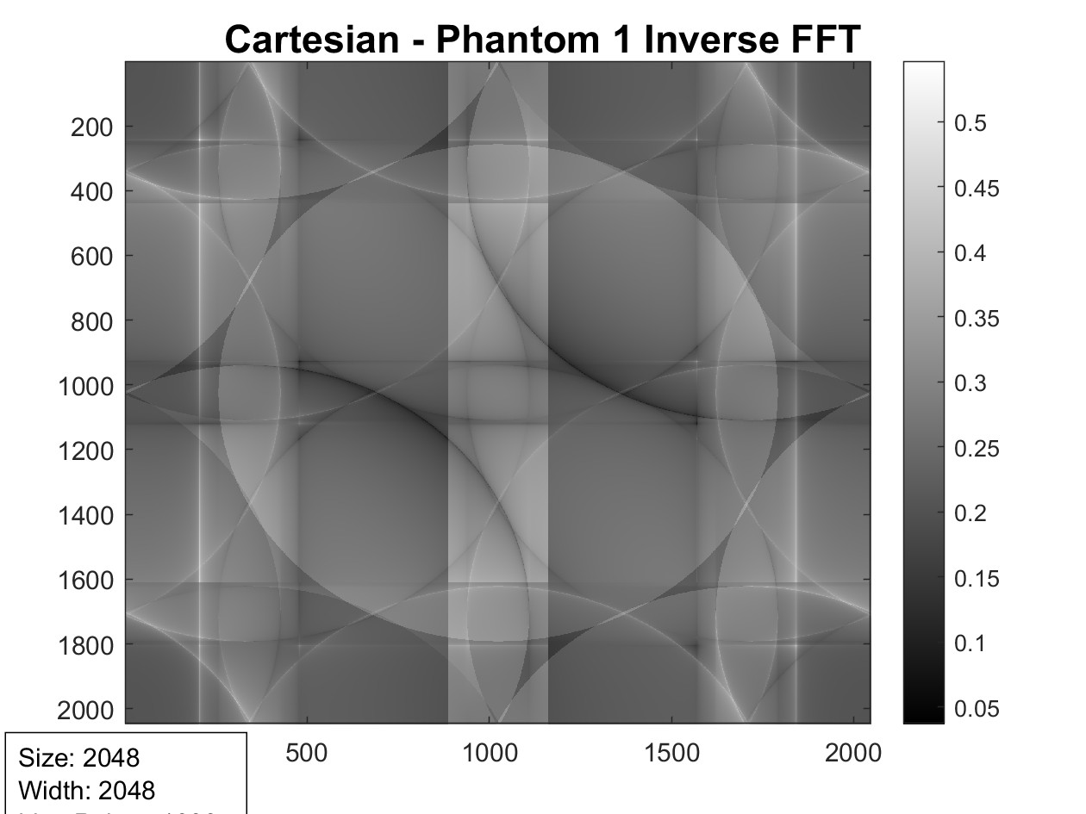
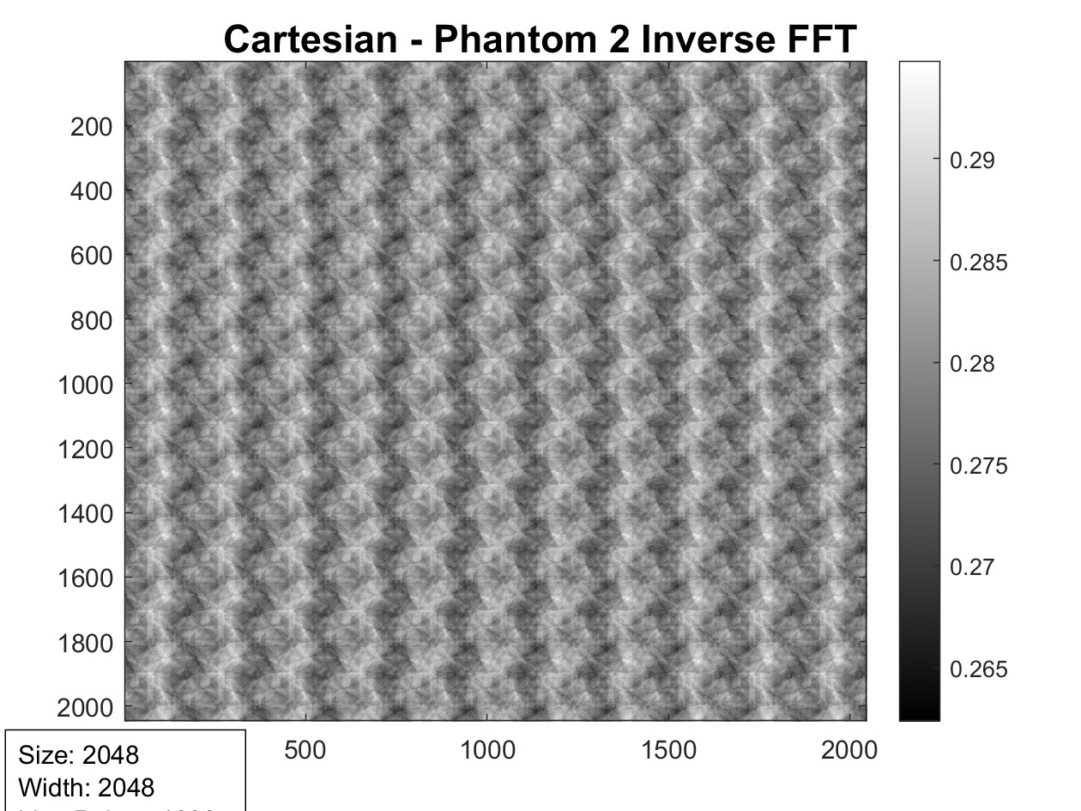
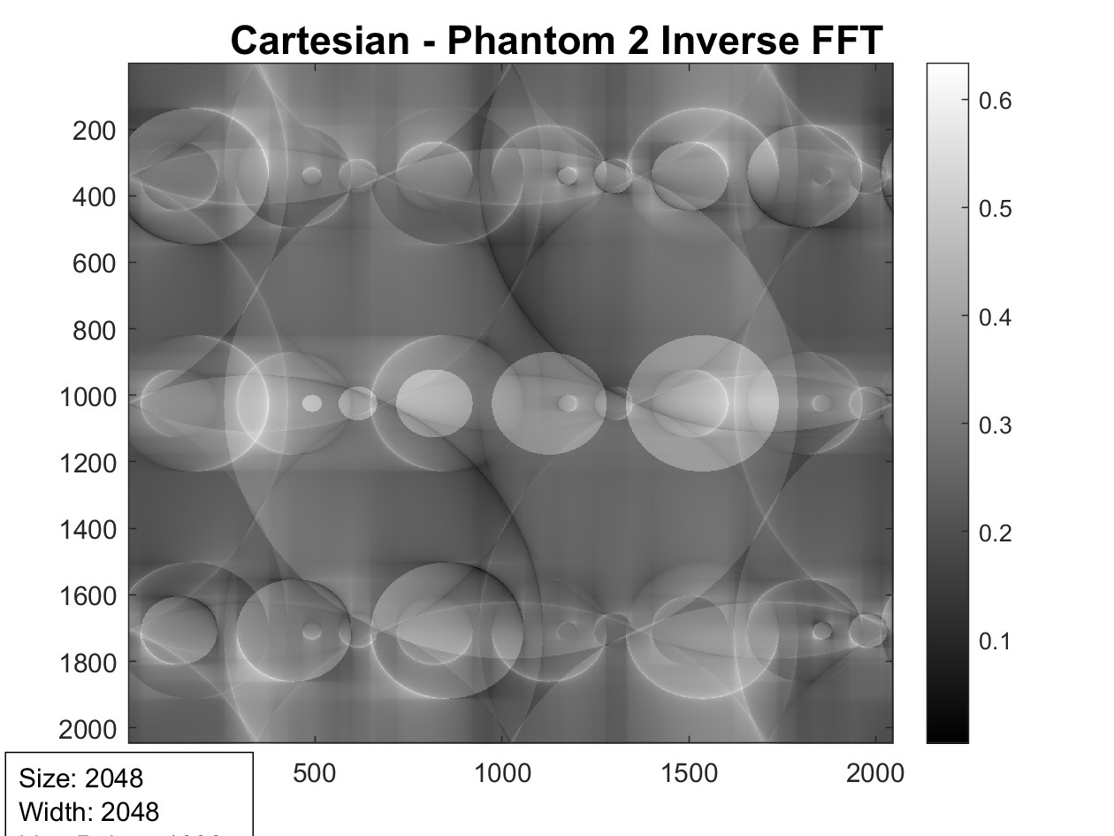
Image Comparisons (Cartesian: Acquisition Time)
Process
Virtual MRI Scanner
Acquisition Time: 0.1
Acquisition Time: 0.9
Acquisition Time Value can be any value between 0 and 1
Visual Clarity for the phantom when increasing the Acquisition Time value

